Slide 1
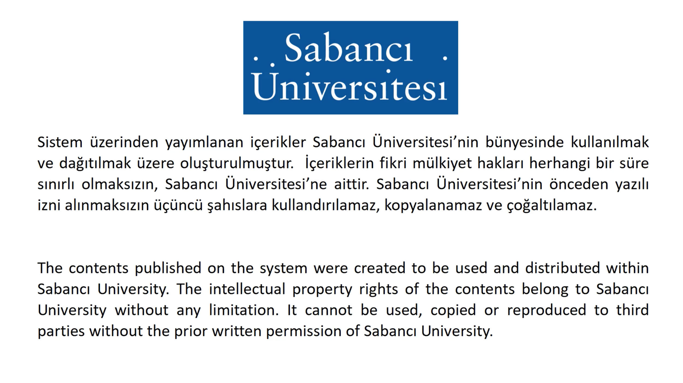

Slide 2
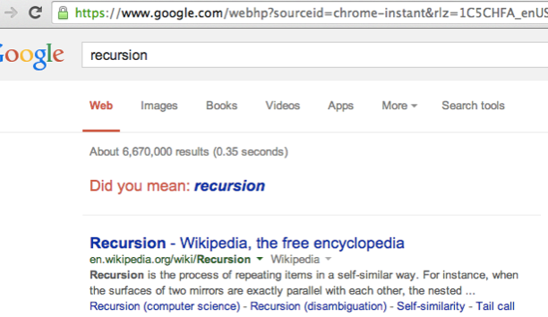
Week-13
Recursion

Slide 3
Recursion (10.1, 10.3)
Recursion is an essential technique in a programming language
Allows many complex problems to be solved simply
Elegance and understanding in code often leads to better programs: easier to modify, extend, verify
Sometimes recursion isn’t appropriate
When it performs bad, it can be very bad!
Need knowledge and experience in how to use it
Recursion is not a statement, it is a technique!
The basic idea is to get help solving a problem from coworkers (clones) who work and act like you do
Ask clone to solve a simpler but similar problem
Use clone’s result to put together your answer
Looks like calling a function in itself, but should be done very carefully!

Slide 4
Print words entered, but backwards
Can use a vector, store all the words and print in reverse order
Using a vector is probably the best approach, but recursion works too (see printreversed.cpp)
void PrintReversed()
{
string word;
if (cin >> word){ // reading succeeded?
PrintReversed(); // print the rest reversed
cout << word << endl; // then print the word
}
}
int main(){
PrintReversed();
return 0;
}
The function PrintReversed reads a word, prints the word only after the clones finish printing in reverse order
Each clone runs a copy of the function, and has its own word variable

Slide 5
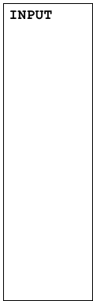

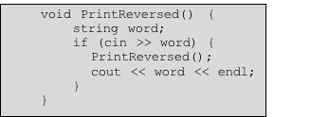












Print words entered, but backwards
How can we print the words in the same order with a small change on the above code?

Slide 6
What is recursion?
Not exactly calling a function in itself
Although it seems like this
Recursion is calling a "copy" of a function in itself
Clone
All local identifiers are declared new in a clone
When execution order comes back to the caller clone, the values in that clone are used

Slide 7
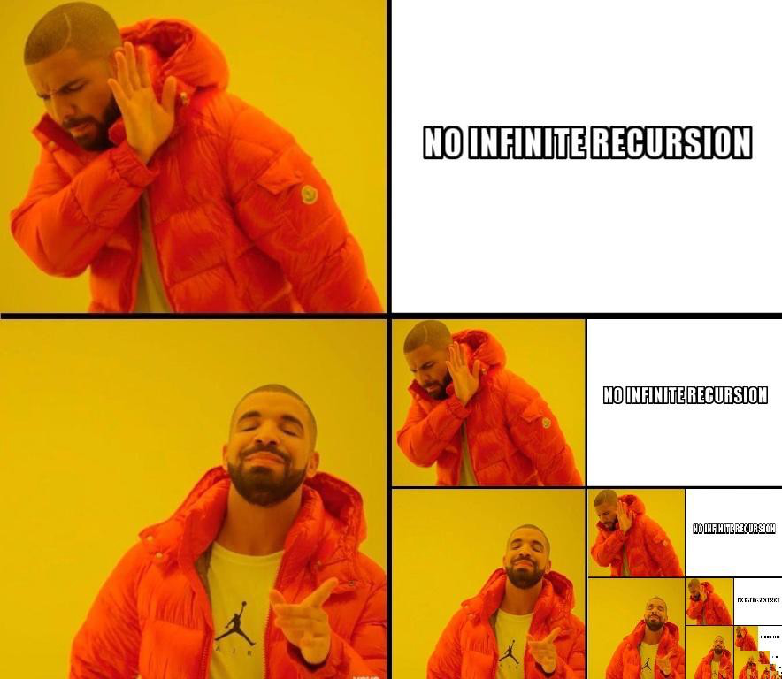
To understand recursion,
you must first understand recursion

Slide 8


Slide 9
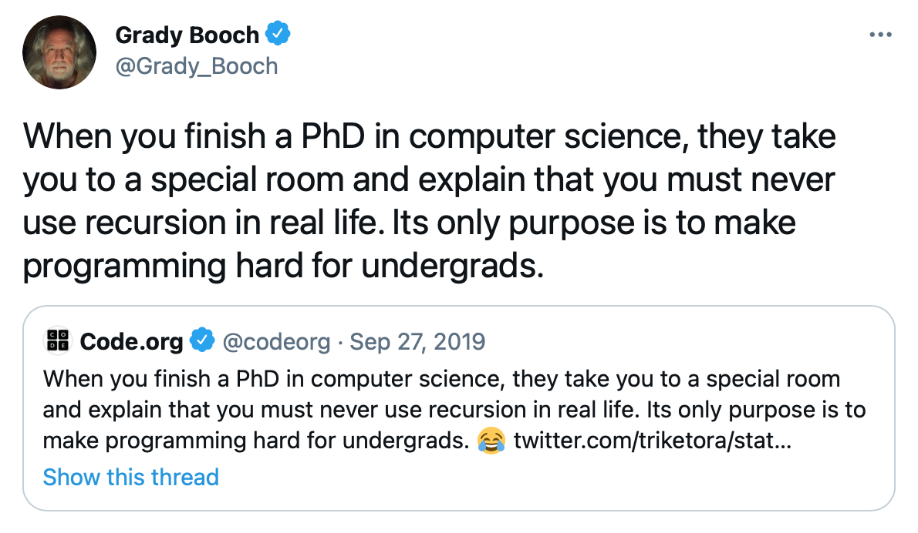

Slide 10
Exponentiation
Computing x^{n} means multiplying n numbers
x.x.x.x.x.x ... x (n times)
If you want to multiply only once, you ask a clone to multiply the rest (x^{n} = x.x^{n-1})
Clone recursively asks other clones the same
Until no more multiplications
Each clone collects the results returned, do its multiplication and returns the result
See the trace on board
double Power(double x, int n)
// post: returns x^n
{
if (n == 0)
return 1.0;
return x * Power(x, n-1);
}

Slide 11
General Rules of Recursion
Although we don’t use while, for statements, there is a kind of loop here
If you are not careful enough, you may end up infinite recursion
Recursive functions have two main parts
There is a base case, sometimes called the exit case, which does not make a recursive call
printreversed: having no more input
exponentiation: having a power of zero
All other cases make a recursive call, most of the time with some parameter that moves towards the base case
Ensure that sequence of calls eventually reaches the base case
We generally use if - else statements to check the base case
Not a rule, but a loop statement is generally not used in a recursive function

Slide 12

Faster exponentiation
double Power(double a, int n)
// post: returns a^n
{
if (n == 0)
return 1.0;
double semi = Power(a, n/2);
if (n % 2 == 0)
return (semi * semi);
return (a * semi * semi);
}
Study the code in 10.1.2

Slide 13
Classic examples of recursion
For some reason, computer science uses these examples:
Factorial: we have seen the loop version, now we will see the recursive one
Fibonacci numbers:
Classic example of bad recursion (will see)
Towers of Hanoi (will not cover)
N disks on one of three pegs, transfer all disks to another peg, never put a disk on a smaller one, only on larger
Peg#1 #2 #3

Slide 14

Factorial (recursive)
BigInt RecFactorial(int num)
{
if (0 == num)
return 1;
else
return num * RecFactorial(num - 1);
}
See 10.3.1 (facttest.cpp) to determine which version (iterative or recursive) performs better?
Almost the same

Slide 15

Fibonacci Numbers
1, 1, 2, 3, 5, 8, 13, 21, …
Find n^{th} fibonacci number
See fibtest.cpp for both recursive and iterative functions and their timings
Recursion performs very bad for fibonacci numbers
Reasons in the next slide

Slide 16
Fibonacci: Don’t do this recursively
5
int RecFib(int n)
// precondition: 0 <= n
// postcondition: returns
// the n-th Fibonacci number
{
if (0 == n || 1 == n)
{
return 1;
}
else
{
return RecFib(n-1) + RecFib(n-2);
}
}
Too many unnecessary calls to calculate the same values
How many for 1?
How many for 2, 3?
4
3
3
2
2
1
2
1
1
0
1
0
1
0

Slide 17
What’s better: recursion/iteration?
There’s no single answer, many factors contribute
Ease of developing code
Efficiency
In some examples, like Fibonacci numbers, recursive solution does extra work, we’d like to avoid the extra work
Iterative solution is efficient
The recursive inefficiency of “extra work” can be fixed if we remember intermediate solutions: static variables
Static variable: maintain value over all function calls
Ordinary local variables constructed each time function called
But remembers the value from previous call
Initialized only once in the first function call

Slide 18
Fixing recursive Fibonacci
int RecFibFixed(int n){
// precondition: 0 <= n <= 30
// postcondition: returns the n-th Fibonacci number
static vector<int> storage(31,0);
if (0 == n || 1 == n) return 1;
else if (storage[n] != 0) return storage[n];
else
{
storage[n] = RecFibFixed(n-1) + RecFibFixed(n-2);
return storage[n];
}
}
Storage keeps the Fibonacci numbers calculated so far, so that when we need a previously calculated Fibonacci number, we do not need to calculate it over and over again
Static variables initialized when the function is called for the first time
Maintain values over calls, not reset or re-initialized in the declaration line
But its value may change after the declaration line

Slide 19
Recursive Binary Search
Binary search is good for searching an entry in sorted arrays/vectors
We have seen the iterative approach before
Now recursive solution
If low is larger than high
Not found
If mid-element is the searched one
Return mid (found)
If searched element is higher than the mid element
Search the upper half by calling the clone for the upper half
If searched element is lower than the mid element
Search the lower half by calling the clone for the lower half
Need to add low and high as parameters to the function

Slide 20
Recursive Binary Search
int bsearchrec (const vector<string> & list, const string & key,
int low, int high)
// precondition: list.size() == # elements in list
// postcondition: returns index of key in list, -1 if key not found
{
int mid; // middle of current range
if (low > high)
return -1; // not found
else
{ mid = (low + high)/2;
if (list[mid] == key) // found key
return mid;
else if (list[mid] < key) // key in upper half
return bsearchrec(list, key, mid+1, high);
else // key in lower half
return bsearchrec(list, key, low, mid-1);
}
}

